Slide 1

Topic Name
Author Name
Institute/ Organization Name,
Place, Country.
© ICIIS 2014

Slide 2

About this Presentation
View this presentation first as a slide show, then view note pages for more detail
Use a good virus checker
Confidentiality not guaranteed
“Test Slide” at end of presentation
© ICIIS 2014

Slide 3
Purpose
Document mandatory standards and recommended guidelines for electronic slide presentation
Provide electronic template
  The file you are reading has settings, colors and fonts that conform to ICIIS-2014 guidelines
  You may edit this file and replace our slides with your presentation
© ICIIS 2014

Slide 4
Outline
Standards vs. Guidelines
Technical specs for electronic slides
Milestones and schedule
Good and bad examples
© ICIIS 2014

Slide 5
Standards and Guidelines
Standard: mandatory requirements for ICIIS-2014 presentations
  Presentation dropped for failure to follow
  Standards are in black italic text
Guideline: suggested good practices
  Result in good visuals
  It’s your choice: Deviate at your own risk
  Guidelines in ordinary yellow text
© ICIIS 2014

Slide 6
Presentation File
One file per presentation
.pdf format (only)
File totally self contained
Preferably 20 Slides, Max of 24 Slides
No links to:
  Other files
  The internet
© ICIIS 2014

Slide 7
Special Fonts or Symbols
Watch out for:
  MS Line Draw
  Wingdings
  Monotype Sorts
  Scientific symbol fonts
Can embed TrueType fonts in file,
© ICIIS 2014

Slide 8
Style Guidelines
Number of slides preferably to be within the bounds as specified earlier
Each slide should have a title
9 lines max on a text slide
In “File->Page Setup…” window specify:
  Slides sized for: “On Screen Show”
© ICIIS 2014

Slide 9
Style Guidelines (cont.)
Short phrases, not long sentences
Title Style
  Verdana, 40 Pts, Single Line
  Try to fit in one line
  If spilling over to next line use 32 Pts
Content Style
  Black, Calibri, 32 Pts
Do not override template as far as possible
© ICIIS 2014

Slide 10
Mandatory Slides
Title slide (logo permitted ONLY here)
Purpose (of your work) slide
Outline slide (of your talk, not your paper)
Detail slides (ie slides 4-23) go here
Conclusion slide
© ICIIS 2014

Slide 11
Other General Tips
Company (university) logo on title slide only
Show only what you will talk about
Use single muted color for blank slides
  Use to focus attention on speaker
© ICIIS 2014

Slide 12
Display Speed & Contrast
Slides should display instantly
Do not distract the audience with slow transition effects
Avoid overuse of slow graphics, fonts and special effects
High contrast very important
Caution: Red, orange or blue lettering and lines may become unreadable when projected
© ICIIS 2014

Slide 13
Transitions Between Slides
Special animation when changing from one slide to another
  Usually highly distracting to audience
  Use only as special attention getter
Default settings should be:
  Effect: No transition
  Speed: Fast
  Advance: On mouse click
Mouse not on podium
  Consecutive slide order, only
© ICIIS 2014

Slide 14
Transitions Between Lines
Can be highly effective
Focus attention on a specific line of a slide
Dim previous lines
Make transitions be instantaneous
Be consistent
© ICIIS 2014

Slide 15
Sound Effects & Borders
DO NOT USE SOUND EFFECTS
Projection computer not connected to sound system
Sound effects slow down slide transitions
Noise from projection computer may distract audience
Do not use borders
They reduce the amount of space available for your text and data
© ICIIS 2014

Slide 16
Diagram slides
Keep diagrams simple
Easy to view
Make text readable
Use all space in rectangle
Example follows:
© ICIIS 2014

Slide 17
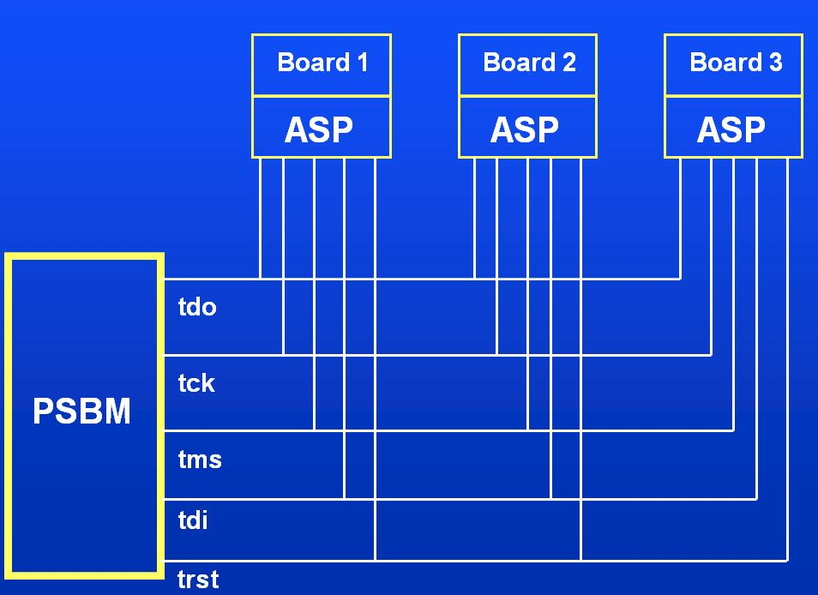
Backplane ASP Connections
© ICIIS 2014

Slide 18
Data - Graphs
Use graphs, not tables
Keep graphs simple
Eliminate or subdue distracting grid lines
Use large font sizes
Example follows:
© ICIIS 2014

Slide 19
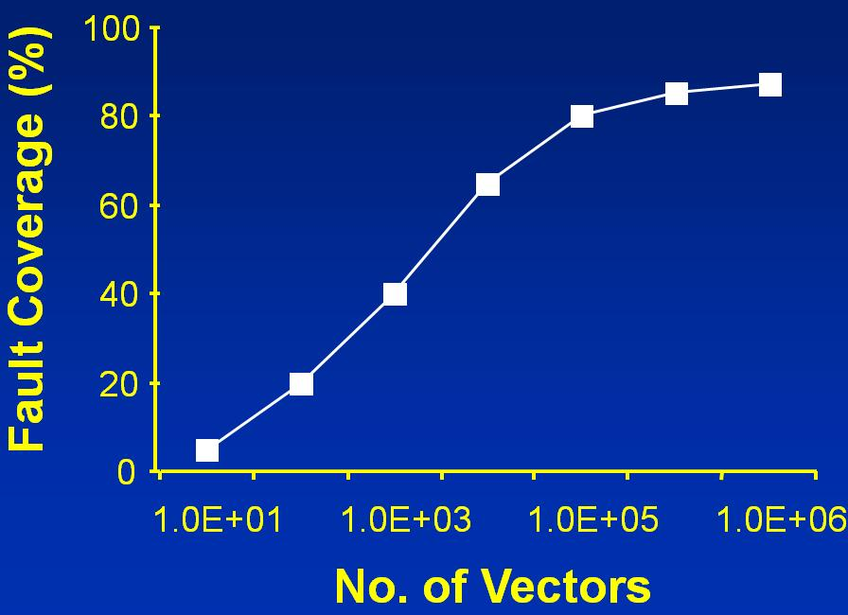
coverage vs. No. of Vectors
© ICIIS 2014

Slide 20
Some Bad Examples
Use graphs, not tables
Keep graphs simple
Eliminate or subdue distracting grid lines
Use large font sizes
Example follows:
© ICIIS 2014

Slide 21
(Press the “Enter” key to continue)
This slide has no title. Titles help guide the audience through the talk. All slides except photographs should have a title.
The type on this slide is too small. It’s readable here, but when projected, only the presenter and maybe those in the front rows will be able to read it. Those in the back will be completely lost.
USE OF ALL CAPITAL LETTERS OR ITALICS also makes slides difficult to read
This slide would be easier to follow if indentations were used.
Don’t design your ICIIS-2014 slides to stand alone. They are a guide to your presentation. If they were understandable by themselves, we could just publish them and forget about presentations! Your slides support what you say: They don’t replace it.
This slide has too many words and too many points. Keep your slides under nine lines.
© ICIIS 2014
Notes:
The text in the “slide” above speaks for itself. Probably no author would combine all the bad practices into one single slide, but a few of the bad practices creep into many presentations each year.

Slide 22
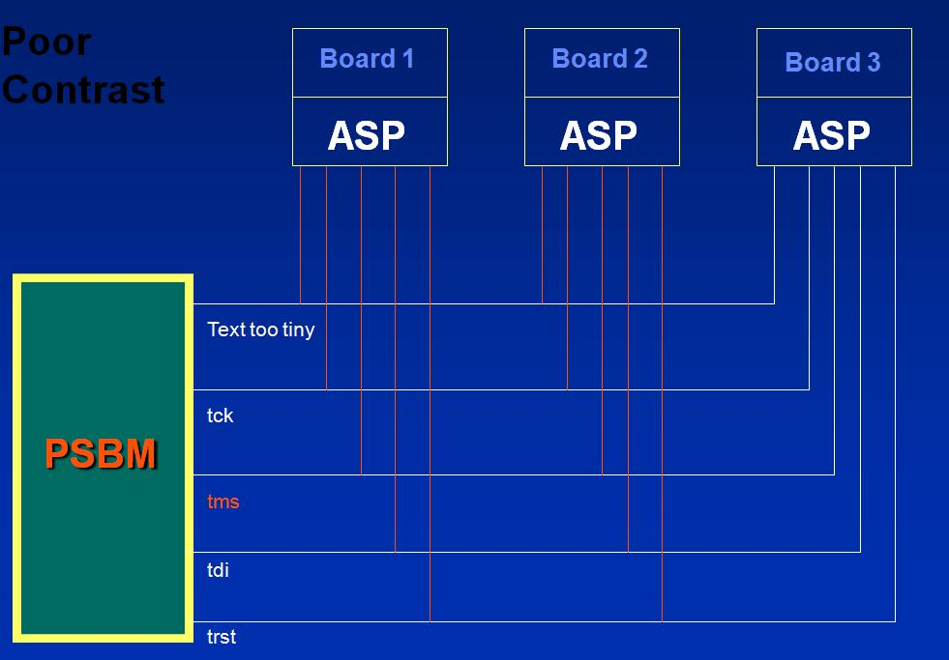
Bad Color Usage
© ICIIS 2014

Slide 23
How to Annoy The Audience (Press Enter)
Misuse sound
Overuse transition effects
Focus the audience on your slides, not the speaker
Try to use every feature PowerPoint has to offer
© ICIIS 2014

Slide 24
Conclusion
Keep your slides simple
Use large fonts for high visibility
  40 pt for titles
  32 pt for details
High contrast colors
Highlight, don’t detail
© ICIIS 2014

